Slide 1
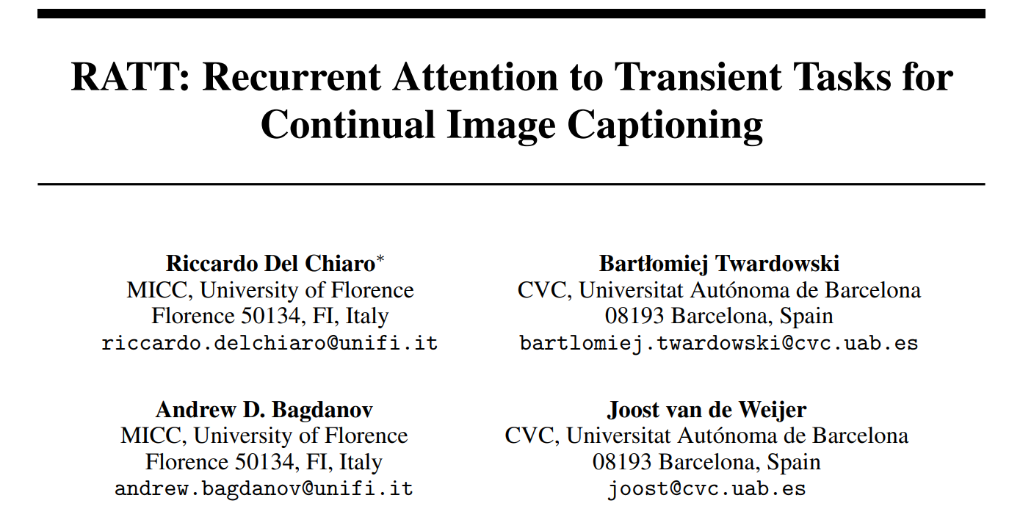
Nips2020

Slide 2
Introduction
Task: continual learning on image captioning
learn five captioning tasks while incurring no forgetting of previously learned ones
Motivation: the phenomenon of catastrophic forgetting
recurrent connections which amplify each small change in the weights
Different from most continual learning settings:
Others’ sets are disjoint
Captioning tasks are naturally split into overlapping vocabularies

Slide 3
Related work: continual learning
Task: Apply the knowledge of one task to another, and not forget the previous task
Baseline:
weight-regularization:
Add restrictions when network parameters are updated
knowledge distillation:
Use the soften softmax output by the teacher model to constrain the samples in the new task.

Slide 4
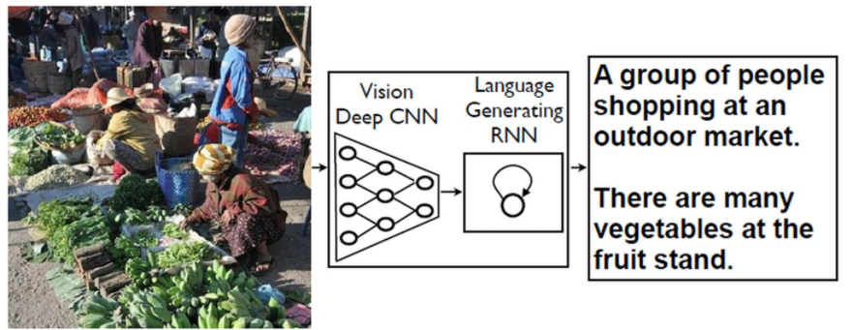




Continual LSTMs for transient tasks
Image captioning Model: Neural Image Captioning
where S = [S1,...Sn] is the target sentence for image I, θ are the model parameters.
Decoder: LSTM
a linear classifier is used to predict the next word at time step n
S is a word embedding matrix
sn is the n-th word of the ground-truth sentence for image I
C is a linear classifier
V is the visual projection matrix that projects image features
loss used to train the network

Slide 5

Continual learning of recurrent models
Catastrophic forgetting for image captioning: classify words at each decoding step, and a large vocabulary of common words are needed for any practical captioning task.
Incremental model
each task have different vocabularies
Basic approach to adapt to the new task is to fine-tune the network over the new training set.
two possibilities:
Use different classifier and word embedding matrices for each task
Use a common, growing classifier and a common, growing word embedding matrix.

Slide 6


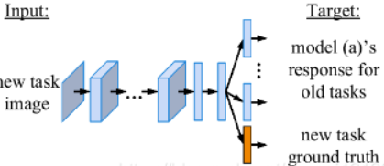
Recurrent continual learning baselines
one based on weight regularization
the other based on knowledge distillation
Weight regularization
knowledge distillation

Slide 7
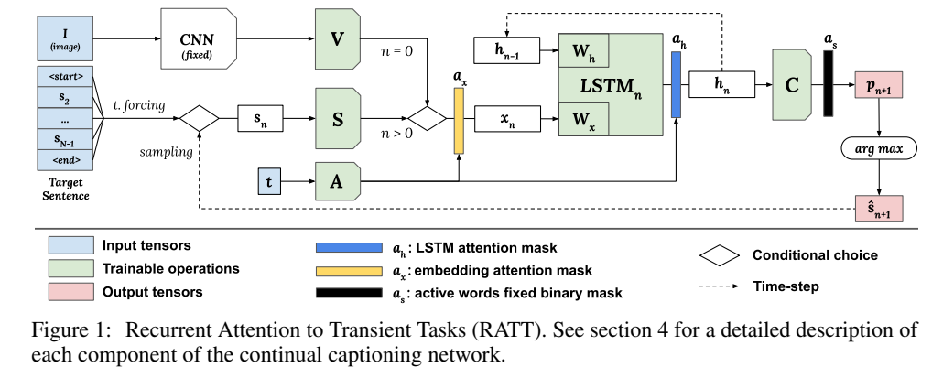





Attention for continual learning of transient tasks
Attention masks
b is the batch index and B is the total number of batches
Smax = 2000 on Flickr30k
Smax = 400 on MS-COCO
Notes:
关键思想是使用关注机制将每层激活的一部分分配给特定任务t。 图1提供了RATT的概述。
用于任务的神经元数量受两个任务条件的注意掩码限制：嵌入注意a t x∈[0，1]和隐藏状态注意a t h∈[0，1]。 这些通过S型激活σ和正比例因子s根据以下公式计算：

Slide 8
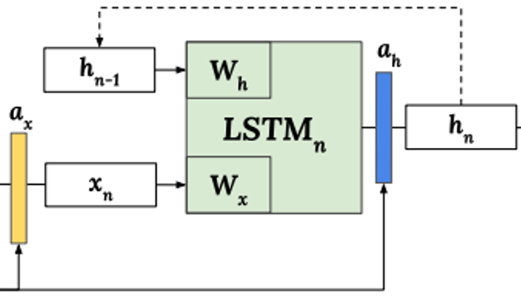




Attention for continual learning of transient tasks
Training
define the cumulative forward mask as:
define

Slide 9



Attention for continual learning of transient tasks
Training

Slide 10
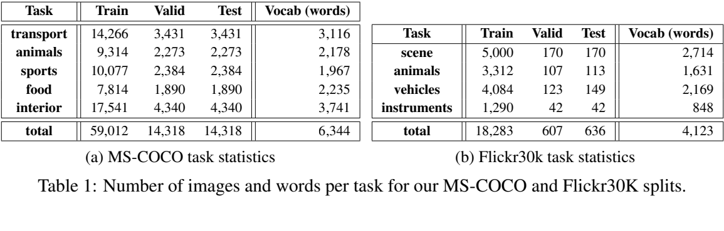
Experimental results
Setting:
encoder network: ResNet151 pretrained on ImageNet.
decoder: the word embedding matrix S projects the input words into a 256-dimensional space
hidden size is 512
MSCOCO
Batch size: 128
learning rate: 4e-4
max-decode length: 26
Flickr30k
Batch size: 32
learning rate: 1e-4
max-decode length: 40

Slide 11
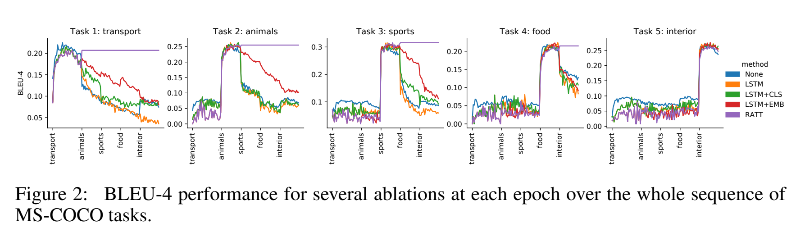
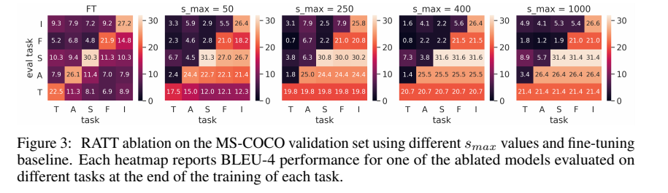
Experimental results

Slide 12
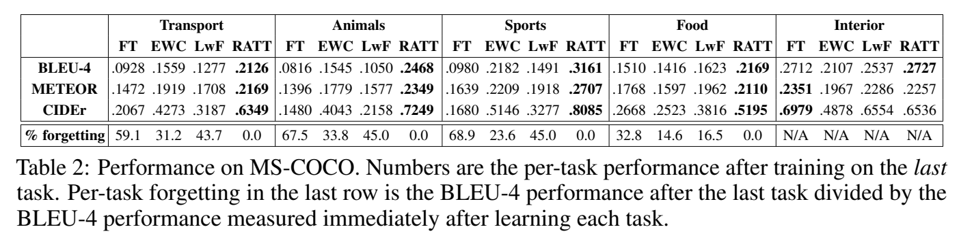
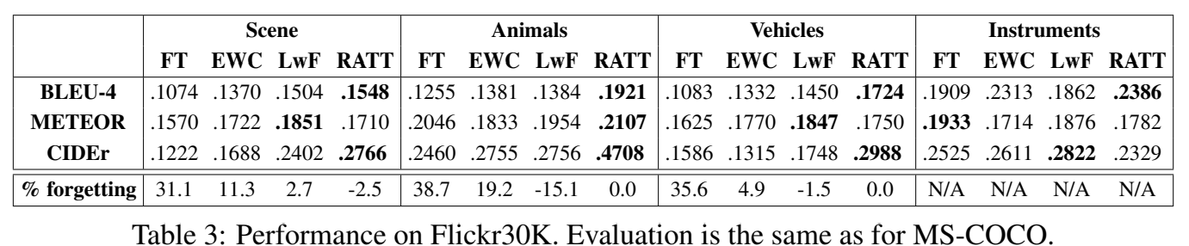
Experimental results

Slide 13
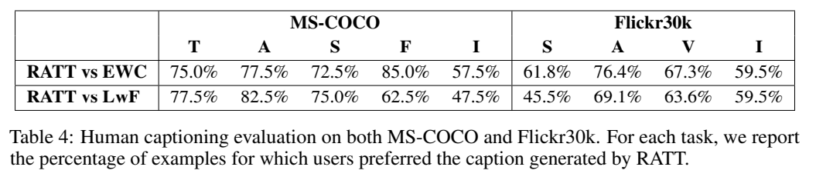
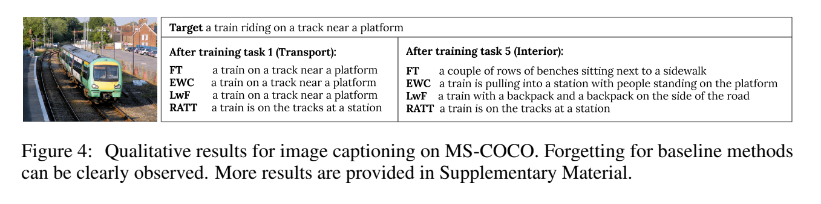
Experimental results

Slide 14
Contributions
Propose a new framework and splitting methodologies for modeling continual learning of sequential generation problems like image captioning
Propose an approach to continual learning in recurrent networks based on transient attention masks that reflect the transient nature of the vocabularies underlying continual image captioning
Support our conclusions with extensive experimental evaluation on our new continual image captioning benchmarks and compare proposed approach to continual learning baselines based on weight regularization and knowledge distillation.

